Slide 1
Cancer
Lesson 5.3
How can we treat cancer?

Slide 2
Do Now
Why do you think cancer therapies are sometimes described as “slash, burn, and poison”?

Slide 3
Different strategies for treating cancer
Surgery
Radiation therapy
Chemotherapy
What are their pros and cons?

Slide 4
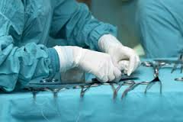
Surgery - pros
Simplest strategy
– cut out the nasty stuff
What’s gone can’t grow or spread
Notes:
Illustration of the Halsted incision and final cut. In 1882 the American surgeon William Halsted first performed what would become known as the Halsted Mastectomy, which involves removal of the entire breast, area lymphatic tissue, and the pectoralis muscle. Halsted achieved a 5-year cure rate of 40% through a number of innovations his aggressive approach to tissue removal, his use of the antiseptic techniques introduced by Joseph Lister, and his introduction of the use of rubber gloves.

Slide 5
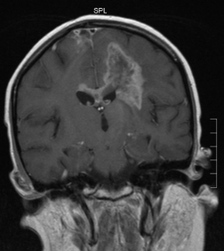
Surgery - cons
Loss of tissue can hamper organ function
Pain, trauma
Clean removal
Metastasis
Risk of infection

Slide 6
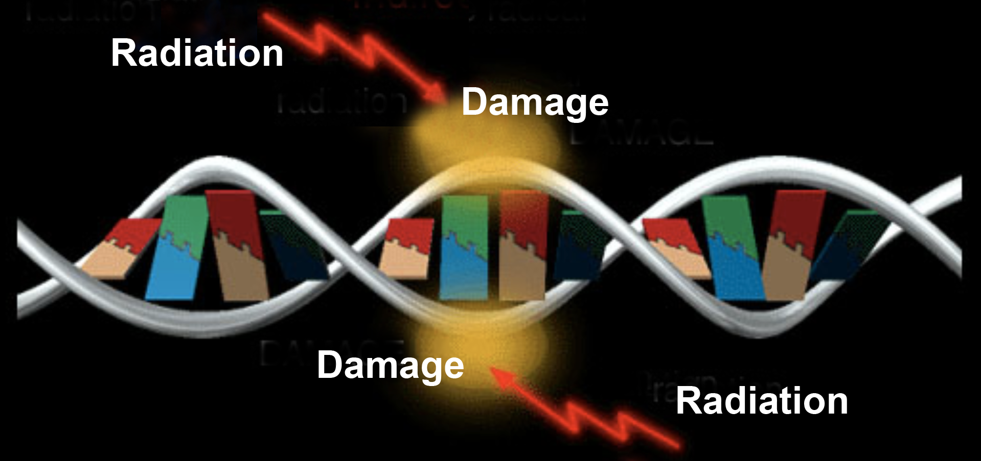
Radiation mechanism
Ionizing radiation – damages DNA
Cells with damaged DNA apoptose or are killed by the immune system
Fastest growing cells are most susceptible
Notes:
quickly dividing cells retain single and double strand breaks during proliferation – accumulate more damage
radiosensitivity varies greatly across cancer types- only used for some cancers
more info: http://www.cancer.gov/cancertopics/factsheet/Therapy/radiation

Slide 7
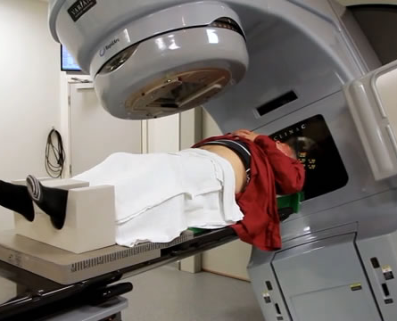
Radiation pros
Minimally invasive
Can be highly localized
Some cancers are very susceptible
Notes:
quickly dividing cells retain single and double strand breaks during proliferation – accumulate more damage
radiosensitivity varies greatly across cancer types- only used for some cancers
more info: http://www.cancer.gov/cancertopics/factsheet/Therapy/radiation

Slide 8
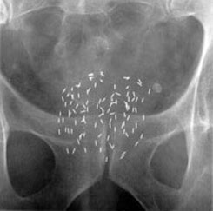
Radiation cons
Must know location
Dose must be minimized or secondary risk
Damages reproductive organs
Some cancers are not
susceptible
No surgery

Slide 9
Chemotherapy Mechanism
Kills rapidly dividing cells
Either blocks DNA replication
Or blocks process of mitosis
✗
molecules to make DNA
✗
DNA replication
✗
✗
Microtubules arrange
chromosomes

Slide 10
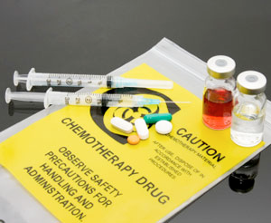
Chemotherapy Pros
Treats whole body – including metastases
Can combine drugs to minimize resistance
Can tailor treatment to specific cancer

Slide 11
Chemotherapy Cons
Kills all rapidly dividing cells - many side effects
Doesn’t kill slowly dividing cells
Some cancers resistant
Most cancers develop resistance

Slide 12
Activity
Break up into groups each having a:
Surgeon
Radiologist
Chemotherapist
Read about your specialty as well as how to read pathology reports, then discuss treatment plans for a patient case study. What factors go into treatment decisions?

Slide 13
Wrap up
How do doctors decide what treatment plan to use?
What information did you wish you had had to make your treatment plan?
Which treatment plan costs the most?

Slide 14
Homework
Read Malcolm Gladwell’s article from the New Yorker: “The Treatment”

